Slide 1

Brandon Tiong
Emanuel Macias
Ege Keser

Slide 2

Background Story
College athletes faced financial hurdles pre-2021 due to stringent NCAA NIL restrictions, limiting their ability to capitalize on talent and reputation.
Recent legislative shifts across states now empower college athletes to seek compensation and sponsorships, unlocking new financial opportunities and personal brand enhancement.

Slide 3
What is SponsorIN?
SponsorIN serves as a dynamic web application fostering collaboration between college athletes and businesses, creating a valuable bridge for mutual benefit.
Our platform is a conducive environment for athletes and companies to network, establish meaningful connections, and cultivate mutually beneficial business relationships.

Slide 4
What does SponsorIN provide?
With SponsorIN, college athletes can proactively showcase their skills, giving them the agency to seek sponsorship opportunities and level the playing field in the competitive sports landscape.
Companies using SponsorIN can easily identify athletes with outstanding potential, offering support to help them grow their personal brands through strategic sponsorship arrangements.

Slide 5
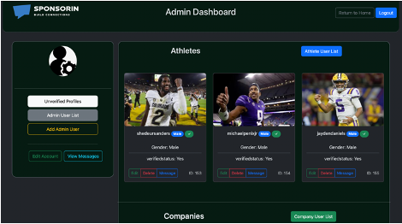
Functionalities
Personalized Dashboards for Each Type of User

Slide 6
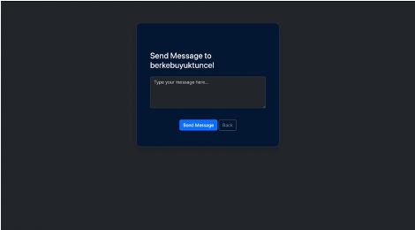
Functionalities
Messaging System Between Users

Slide 7
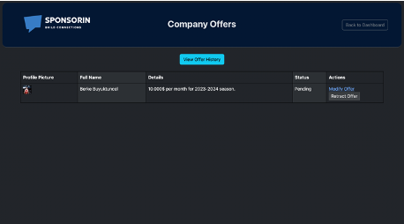
Functionalities
Offer Management System for Athletes and Companies

Slide 8
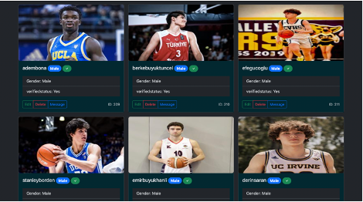
Functionalities
Profile Verification for a
Safer Platform

Slide 9
Responsibilities
Brandon Tiong: Full-Stack Developer, mainly backend.
Emanuel Macias: Full-Stack Developer, mainly frontend.
Ege Keser: Full-Stack Developer, mainly data, documentation and support for backend and frontend.

Slide 10
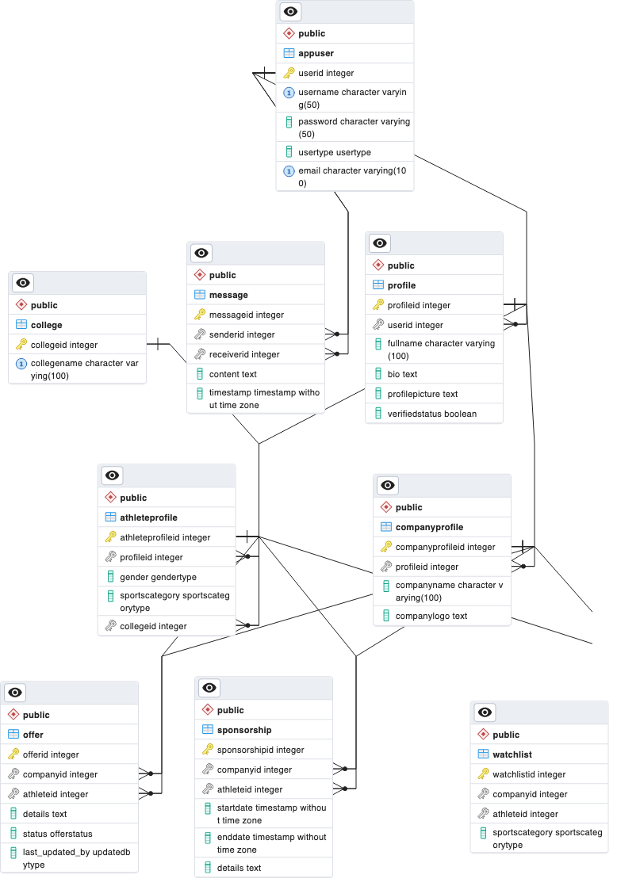

Database
9 Tables
PostgreSQL

Slide 11


BACKEND
app.py
1320 Lines
50+ Methods and Functions
Python + Python Flask

Slide 12




FRONTEND
38 Web Pages
Bootstrap + HTML + CSS + JavaScript

Slide 13
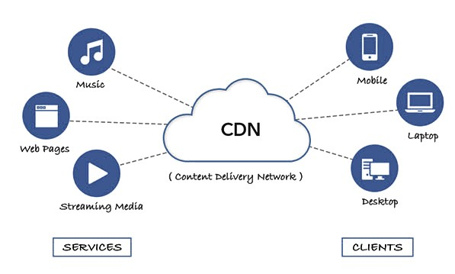
Content Delivery Network (CDN)
Distributes content to users from nearest server.
Enhances user experience.

Slide 14
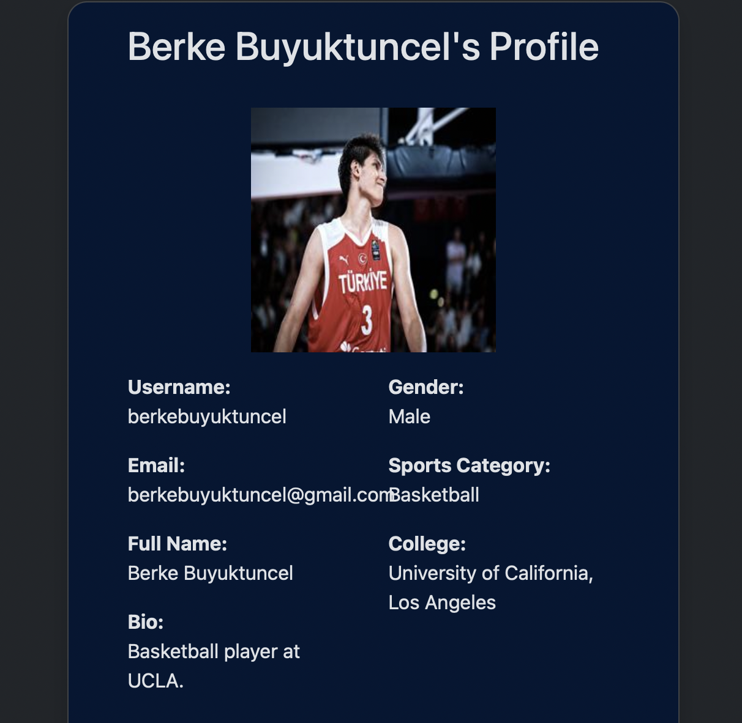
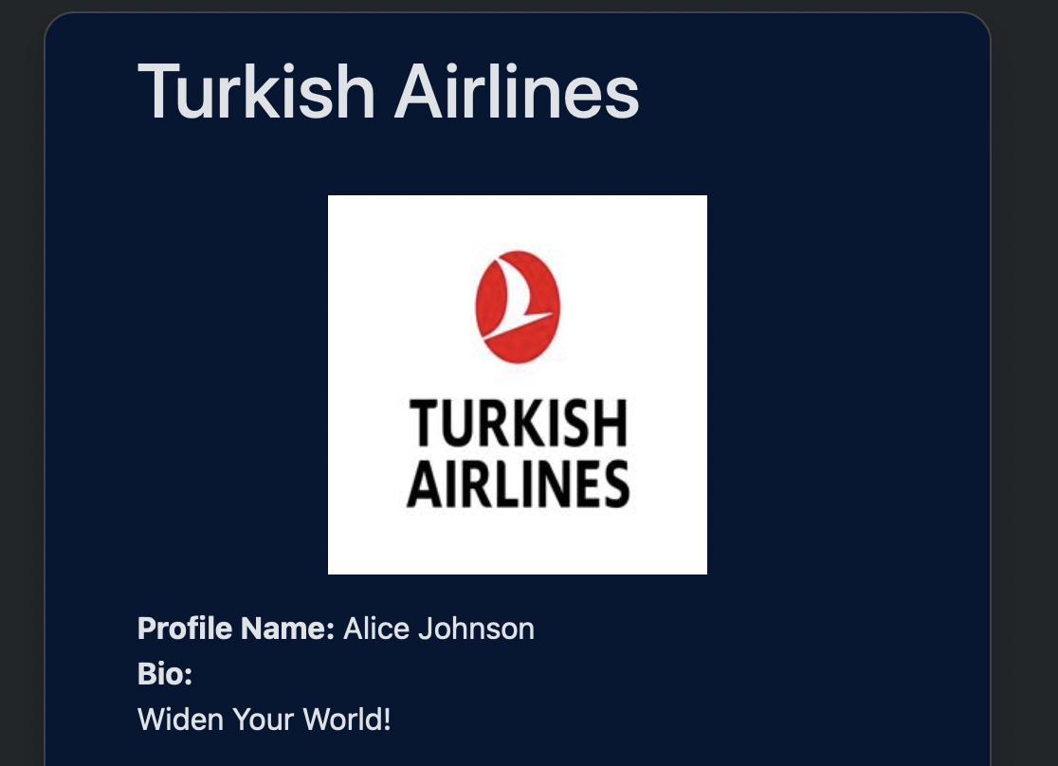
DATA
150 Athlete Profiles
50 Company Profiles

Slide 15
Live Demo

Slide 16

Thank you!
Questions or Comments?

